Slide 1
LSST Data Management Organization and Communications Jeffrey Kantor DM Project Manager October 6, 2015
Data Management Boot Camp
October 5 – 7, 2015| LSST, Princeton, UW

Slide 2
Agenda
Organization
DM Team and Staffing
DM Organization
DM Internal Teams
Data Management as part of NSF MREFC Project
Communications
Regularly Scheduled Meetings
Group Collaborative Tools
Planning and Management Tools
Documentation and Document Management
Note: Development Tools are covered in another session

Slide 3
Organization

Slide 4
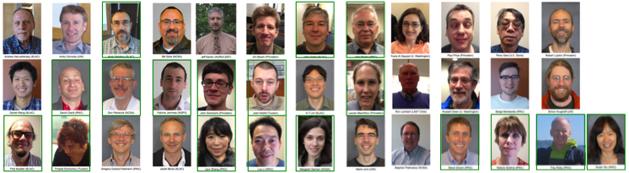





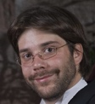
DM Team and Staffing
Staff has more than doubled in 12 months, now 48 people
28 new team members added since MREFC award (20.5 FTE)
Have 32.5 FTE hired/assigned as of now
FY16 budget and institutional plans support hiring to revised profile of 50 FTE for SV recovery
Will be done using underspend, no contingency
Level of expertise/experience remains high as we staff up
Added since MREFC Award
Ian Sullivan (UW)
David Nidever
(UA)
Angelo Fausti
(LSST)
Matias Arrosco
Kind (NCSA)
Jason Alt
(NCSA)
Bob Armsgtrong
(Princeton)
Jmatt Peterson
(LSST)
DM Team

Slide 5










Going Where the Talent is: Distributed Team
User Interfaces
Database
Mgmt, I&T, and Science QA
Science Pipelines
Middleware
Infrastructure
Notes:
LSST Cake
Stairway to Heaven

Slide 6
DM Construction/Commissioning Phases Organization
LSST Project Office/
Business Office
DM Project Manager *
DM Project Engineer **
DM Project Scientist **
LSST Director
LSST Science Council
DM Science Quality and
Reliability Engineering Lead **
DM SQuaRE Technical Manager **
DM System Architect **
DM Deputy System Architect **
DM System Interfaces Scientist **
LSST System
Engineering
Middleware & Infrastructure Lead Institutions
Applications Lead Institutions
Science Database and
Data Access Services
(SLAC) **
Science User Interface
and Tools
(IPAC) **
Processing Services/Tools
And Site Infrastructure
(NCSA) **
Base Site, Long-Haul
Networks
(NOAO) **
Alert Production
(UW) **
Data Release and Calibration Products Productions
(Princeton) **
* DM LeadershipTeam
** and DM Science/Architecture Team
LDM-294 Data Management Organization and Charter
Notes:
Blue highlights show IPAC positions/responsibilities/co-locateds
PMC, SAT, TCT, SST are cross-functional, IPAC full member and/or chair

Slide 7
Institution Leaders
Each Lead Institution has a Technical/Cost Account Manager (T/CAM) and Scientific/Technical Lead (S/TL), who jointly have overall end product responsibility for a broad area of DM work, typically a Work Breakdown Structure (WBS) Level 2 element
They can be one or two people depending on institution
T/CAM roles and responsibilities are similar to the DM Project Manager, but within the scope of work assigned to that institution
Plans, budgets, schedules, reporting, recruiting staffing, etc.
S/TL roles are responsibilities are similar DM Project Scientist, and DM System Architect, but within the scope of work assigned to that institution
Scientific and technical leadership on requirements, architecture, design, implementation, test, integration, etc.

Slide 8
Cross-organizational internal teams
Internal teams provide integration of management, resources, plans, process, architecture, and interfaces across entire DM team
DM Leadership Team (LT)
Institution S/TLs and T/CAMs
Meets weekly
Science/Architecture Team (SAT)
Meets monthly or as needed (may be superseded by RFD, etc.)
Working Groups (WG)
Applications, Middleware, Infrastructure, Database, Operations
Technical Control Team (TCT)
Manage/approve Technical Baseline (see collection-2511)
Meets as necessary
Notes:
IPAC has membership/co-chair with all control bodies

Slide 9
LSST DM as part of NSF MREFC Project
You are all members of the “LSST Project”
The LSST Project is being funded and conducted as a joint project by the NSF and the DOE, with participation by Chile and other International Partners
The LSST Camera is funded as a Major Item of Equipment (MIE) project by the DOE
The other parts of the Project (PMO, DM, EPO, System Engineering) are funded as a Major Research Equipment and Facility Construction (MREFC) project
These cover the construction and commissioning (but not operations) of the LSST
There are MANY rules about what is allowed on project funding
The rules vary somewhat between NSF and DOE
With NSF, DM pipelines OK, “doing general science” NOT OK
Notes:
T/CAMs and PM can tell you what is allowable/not allowable

Slide 10
Communications

Slide 11
Regularly Scheduled Meetings
Online Meetings
Internal Team Meetings (e.g. SAT, DMLT, TCT, WGs)
WBS Oriented Meetings (e.g. SUI, Infrastructure, …)
Technical Coordination Meetings (e.g. Coordination Stand-ups)
Face to Face Meetings
Entire DM Team
LSST Project and Community Workshop in August, location varies
Annual DM All Hands Meeting in February, location varies
DM Leadership Team
At DM Team Meetings plus in October/November, May/June, location varies
DM Meetings google calendar
DM Travel google calendar
Notes:
These are only the scheduled ones, not ad hoc
Ask your T/CAM which meetings you should attend
Ask Libby Petrick for access to google calendars

Slide 12
Group Collaboration Tools
Mailing lists (lists.lsst.org, listserv.lsstcorp.org)
Hipchat (hipchat.com)
Discourse (community.lsst.org)
Confluence (confluence.lsstcorp.org)
JIRA (jira.lsstcorp.org)
Bluejeans (bluejeans.com)
GoToMeeting (gotomeeting.com)
URL shortener (ls.st)
google hangouts (ls.st/sup, …)
American Teleconnect Lines (866 330 1200, passcode xxx)
project.lsst.org
Travel, Contacts, Calendars, Interactions, Risk Management, …
Notes:
Many require an account, part of your onboarding process
Bluejeans, GoToMeeting require account to set up meeting
listerv.lsstcorp.org going away
Ask your T/CAM or Libby if you want to schedule, she can point you to right person

Slide 13
Data Management Planning Process/Levels
LSST System Requirements and Operations Plans
Project Risks & Milestones
DM Roadmap (LDM-240)
High-level picture
Granularity: 6 months
DM System Requirements and Roadmap
Institutional-level resource assignments
Budgeting
Earned-value management
Basis of monthly reports
Granularity: 3 - 6 months
2 x 6-month development/release cycle per year
10-20 activities for each cycle
PMCS
Detailed 6-month plan
Developed from Agile Process (Epics, Stories)
Individual resource assignments
~100 activities per cycle
Granularity of activities: 1 – 3 months
Granularity of steps within activities: 2 – 20 days
Release Plan

Slide 14
JIRA for Task-level Work Planning and Tracking
Software Development and some non-software efforts are planned and managed at the task-level using JIRA and JIRA Agile add-on
Web based interface for easy access by the people doing the work
“Issues” cover essentially all task-based work
Tracks all history and actions on the Issue being updated
Excellent tool to collect status on the work being performed
Add a JIRA Issue as soon as you suspect something is an issue or needs to be done, anyone can do this
Ordinary bugs can be filed as a JIRA bug (type of Issue)
Use Request for Comment process to notify and discuss an issue or need that is more complex or larger scope

Slide 15
JIRA Agile
JIRA Agile adds “agile process” to JIRA in the form of Stories, Epics, Sprints, Kanbans, etc.
Software development is generally scheduled in Sprints, while other activities (support, sys admin, etc.) are generally Kanbans
Developers and T/CAMs create Stories (and Improvements, Bugs), and organize into Epics for higher level planning
Stories are preferably 2 – 20 Story Points
Stories are complete or not; we don't track progress inside stories
Story completion adds to the completion level of their Epic
New Stories can be added to an Epic during the cycle
Report when a Story is done to your T/CAM (same day if possible, NLT same week)
Stories can be deprecated by marking “Invalid” or “Won’t Fix”
If a Story or Epic becomes irrelevant, smaller, or larger, let your
T/CAM know; we can adjust
Notes:
T/CAMs can help with all of this

Slide 16
JIRA to PMCS Integration for 6-month plans
We are required by the NSF to use a Project Management Control System (PMCS) for scheduling and Earned Value Management (EVM)
To prevent duplication of effort, information provided in JIRA is integrated into Primavera (a part of the PMCS)
JIRA Epic = Primavera Activity
JIRA Story = Primavera Step
To enable EVM, we do a “rolling wave” plan for each 6-month release cycle
6-month planning is done at the level of Epics with Story Points estimated up front at the beginning of the cycle
Sprint planning is done at the level of Stories throughout the cycle
Epics can be added during the cycle, but it requires a change request

Slide 17
Documentation and Document Management
Working versions of documents are developed in a variety of tools (wikis, LaTex, MS Word, Acrobat, etc.)
Official baseline versions of documents are stored in docushare
The LSST requirements and interface control documents are in collection-2808 and collection-2807
The LSST monthly technical progress reports are in collection-3826
The DM requirements and design documents are in collection-2511
The DM monthly technical progress reports are in collection-221
There are many more related documents, both management and technical, ask your T/CAM if you need to find something

Slide 18
Backup/Dropped Slides

Slide 19
DM Charter - Mission
The mission of Data Management Organization (DMO) is to provide technology and operational capabilities for the acquisition, quality assessment, processing, end user and external system access, provenance, and archiving of open, publicly accessible, scientific data and associated engineering and quality data generated by the LSST as a result of scientific projects and telescope operations.
LDM-294 Data Management Organization and Charter

Slide 20
DM Charter – Goals and Objectives
The Data Management Organization will:
Define the data products, data access mechanisms, and data management and curation requirements for the LSST
Assess current and LSST-timeframe technologies for use in providing engineered solutions to the requirements
Define the computing, communications, and storage infrastructure and services architecture underlying LSST data management
Select, implement, construct, test, document, and deploy the LSST data management infrastructure, middleware, applications, and external interfaces
Document the operational procedures associated with using and maintaining the LSST data management capabilities
Evaluate, select, recruit, hire/contract and direct permanent staff, contract, and in-kind resources in LSST and from partner organizations participating in LSST Data Management initiatives
LDM-294 Data Management Organization and Charter

Slide 21
Development Tools
Open-Source Development Tools
git
GitHub
eups
lsstsw
scons
doxygen
Jenkins
…
Details and instruction in tutorial later today

Slide 22
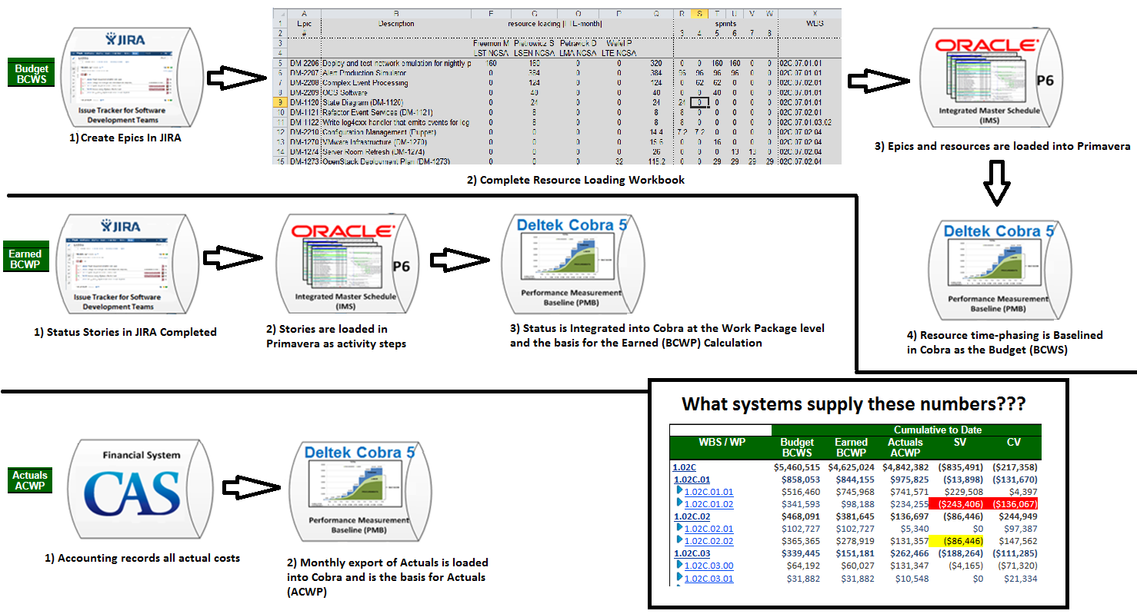
Planning and Tracking Data Flow
Institution Invoice and
WBS/Account Breakout

Slide 23
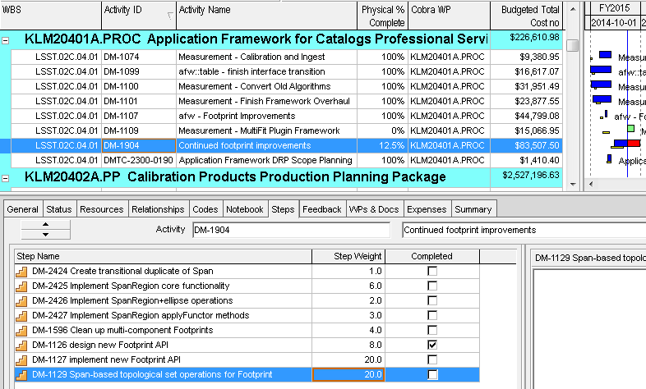
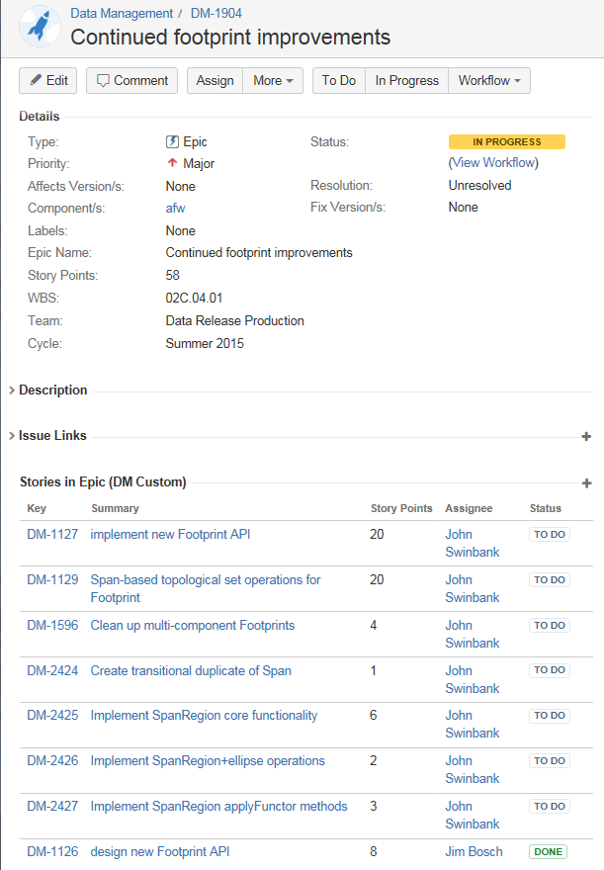
In Progress Epic Example (Jira to Primavera)
JIRA
Primavera
One Story has been completed on this Epic
Weight in Primavera matches the Story Point in JIRA.
% Complete in Primavera calculates as 100% when all stories are complete.

Slide 24
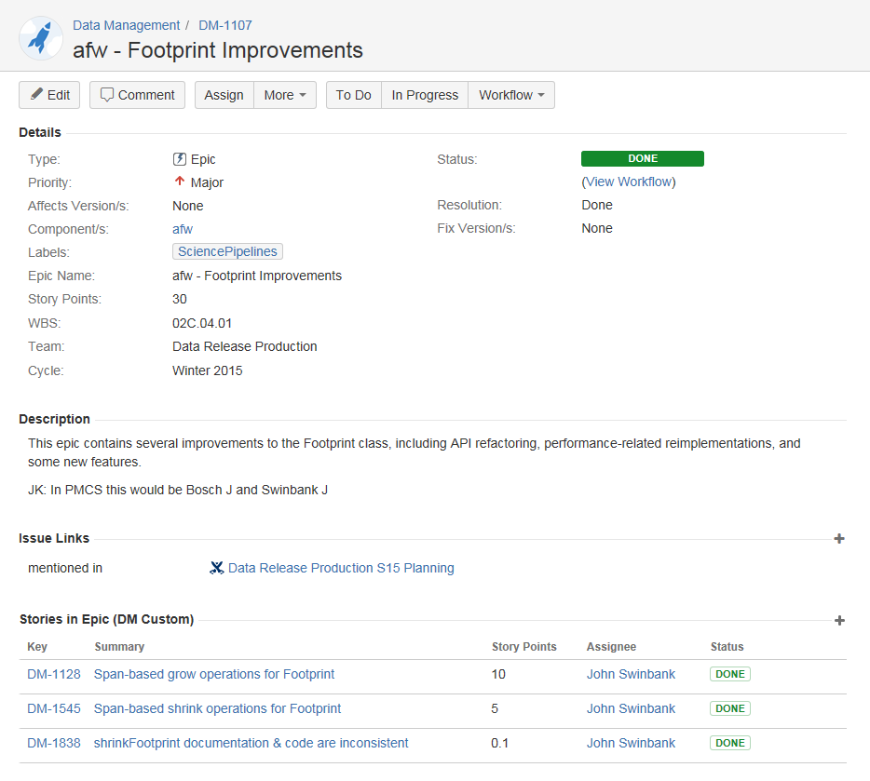
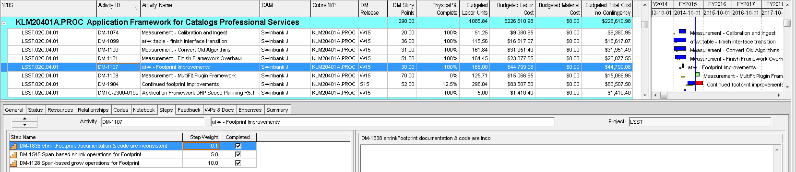
Completed Epic Example (Jira to Primavera)
JIRA
Each Jira story is assigned as an activity step in Primavera.
Weight in Primavera matches the Story Point in JIRA.
% Complete in Primavera calculates as 100% when all stories are complete.
In this case all Stories in Epic are completed so the epic and activity are marked as complete.
Primavera

